Slide 1
Chapter 6 Learning
Chapter Review

Slide 2
Important things to know
The principles and elements of classical conditioning
Factors that determine whether conditioned response are learned.
The principles and elements of operant conditioning
Factors that form and strength operant behavior
Latent learning
Observational learning

Slide 3
What is classical conditioning ?
A procedure in which a neutral stimulus is paired with a stimulus that triggers an automatic response until the neutral stimulus alone comes to trigger a similar response.
E.g., bell ring paired with meat powder
Meat power is the UCS, salivation caused by meat powder is UCR, bell ring which triggers salivation is the CS, salivation triggered by the bell ring alone is CR

Slide 4
Three phases in classical conditioning
Phase 1: UCS leads to UCR, neural stimulus does not
Phase 2: Neutral stimulus followed by UCS, leading to UCR
Phase3: Neutral stimulus alone (CS) leads to CR

Slide 5
What is stimulus generalization?
A conditioned response is trigger by stimuli similar too the original conditioned stimulus.
E.g., you became afraid of not only doctor’s white coat (CS) but also your dad’s white trench coat.

Slide 6
What would happen if the conditioned stimulus is not paired with the unconditioned stimulus for a few times?
The conditioned response disappears.
This process is called extinction.

Slide 7
How does timing of stimuli play a role in developing conditioned response?
Classical condition works best when the conditioned stimulus comes before the unconditioned stimulus.
E.g., ring followed by meat powder

Slide 8
What is law of effect?
If a response made to a particular stimulus is followed by a satisfying effect, the response is more likely to occur the next the stimulus is there.

Slide 9
What does each of the following component of operant conditioning mean?
Operant, or operant response.
Reinforcers: positive and negative

Slide 10
How timing of the reinforcement influence operant behavior?
Operant behavior is more easily developed when the reinforcement follows right after a behavior.
Think about the example of drinking alcohol.

Slide 11
Reinforcement schedules
Continuous schedule: reinforce every correct behavior
Partial schedule: four types of partial reinforcement schedule
Fix-ratio
Fix-interval
Variable-ratio
Variable-interval

Slide 12
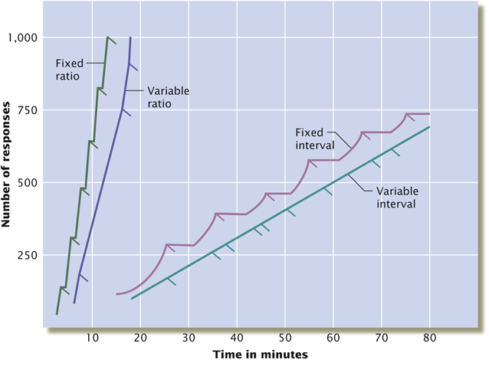
Schedule and Extinction
Continuous reinforcement makes behaviors more subject to extinction; partial reinforcement makes behavior more resistant to extinction.
Fixed- and variable-ratio produce higher rates of behavior

Slide 13
What is the difference between punishment and reinforcement?
Punishment REDUCES the frequency of an operant behavior.
Reinforcement, positive or negative, INCREASES the frequency of operant behavior.

Slide 14
What is learned helplessness
A tendency to give up on effort to control the environment, because previous experience told you that no control is possible.

Slide 15
What is latent learning?
Learning that had occurred but was not evident when it first took place.

Slide 16
What is observant learning?
Learning by watching others.
Children are particularly influenced by this type of learning.

